Slide 1
MID TERM EVALUATION OF PROJECT WORK “ Learning Can be Fun”
Under Guidance of: Presented by Team:36
Swetha P M
Asst Professor
Dept CSE
JSSSTU Mysuru
Submitted by:
Paavana : 01JST17CS103
Sona Agrawal : 01JST17CS153
Vishak S: 01JST17CS177
Yashwanth H L: 01JST17CS180

Slide 2
CONTENT
1.Statement of Problem
2.Aim &Objective
3.Applications
4.Solution Methods
5.Literature Survey
6.System Requirements & Analysis
7.Tools & Technology used
8.System design & system implementation
9.Details of modules/objectives completed

Slide 3
Statement of Problem
Preschool age is critical for kid’s development. A good reading ability and understanding of any child depends on the training he/she receives. This requires the parents to invest more time and money on materials and tools.

Slide 4
AIM
To design and develop a web based application that will achieve an activity based learning and focuses on using real-world objects to facilitate pre-school learning of the English alphabets, spellings, counting of numbers, recognition and drawing of real world objects.

Slide 5
OBJECTIVE
To train our model to identify and classify scribbled alphabets, digits, and drawings.
To create two sections: Learning and Drawing
To design a system with friendly navigation, backgrounds, sounds and colours to attain the attention of kids while learning.
To show the child’s progress after a certain period of time.

Slide 6
Proposed Solution
we have come up with a neural network based solution to classify doodles and we are classifying the images into 3 category i.e (easy , medium , hard )and also in front end we have used some canvas element using technique like reactJS etc .

Slide 7
Literature survey
The authors "Anchit Shrivastava, Isha Jaggi, Shefali Gupta, Deepali Gupta" analysed the most suitable and best method for digit recognition by considering 60,000 images for training set with a pixel size of 28×28. The images/training sets were matched with the original image. It was found out after complete analysis and review that the classifier ensemble system has the least error rate of just 0.32%. They also reviewed different methods of handwritten digit recognition.
The authors “Tsung-Han Tsai, Po-Ting Chi, Kuo-Hsing Cheng” built a sketch classifier technique with deep learning models. They had used the depth-wise convolution layer to lighten the deep neural network. The result showed the improvement in approximately 1/5 of computation. They had used Google Quick Draw dataset to train and evaluate the network, which can have 98% accuracy in 10 categories and 85% accuracy in 100 categories. The system can achieve real-time implementation of sketch classification.

Slide 8
The authors Olisah Kingsley S and Mohamed Ismail Z conducted a review on three possible solutions that can improve learning and teaching in pre-schools. The report also developed the most appropriate solution that will answer the research questions. Their research shall also discuss the importance and impact of information and communications technology on teaching and learning in pre-schools. It also discussed the advantages and disadvantages of web-based e-learning system over traditional kids learning.

Slide 9
REQUIREMENTS
USER INTERFACES
The user interface for the software shall be compatible to any browser such as Internet Explorer, Mozilla by which user can access the system.
The user interface shall be implemented using any tool or software package like Java Applet, MS Front Page, EJB etc.
HARDWARE INTERFACES
Processor: Dual Core
RAM: Min 2GB
Hard Disk: 20mb
A browser which supports HTML, JavaScript
Since the application must run over the internet, all the hardware shall require to connect internet will be hardware interface for the system. As for e.g. Modem, WAN – LAN, Ethernet Cross-Cable

Slide 10
Tool and Technology and Framework used
Language used: JavaScript, Html, CSS, Python
IDE used: Visual Studio Code, Jupyter Notebook
Framework used: Python Flask, OpenCV, Tensorflow,React Js

Slide 11
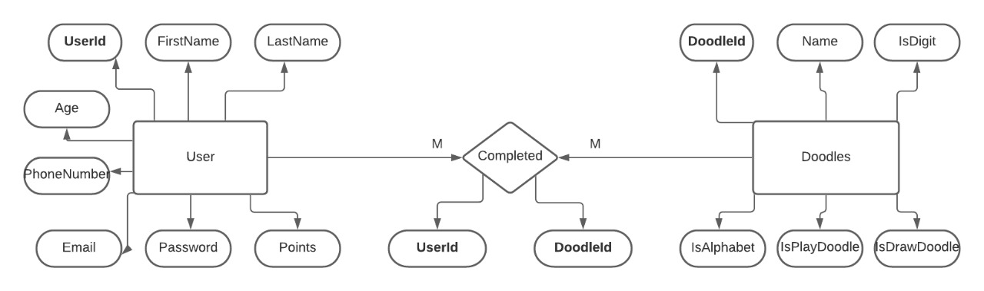
Relationship Schema

Slide 12
IMPLEMENTATION

Slide 13
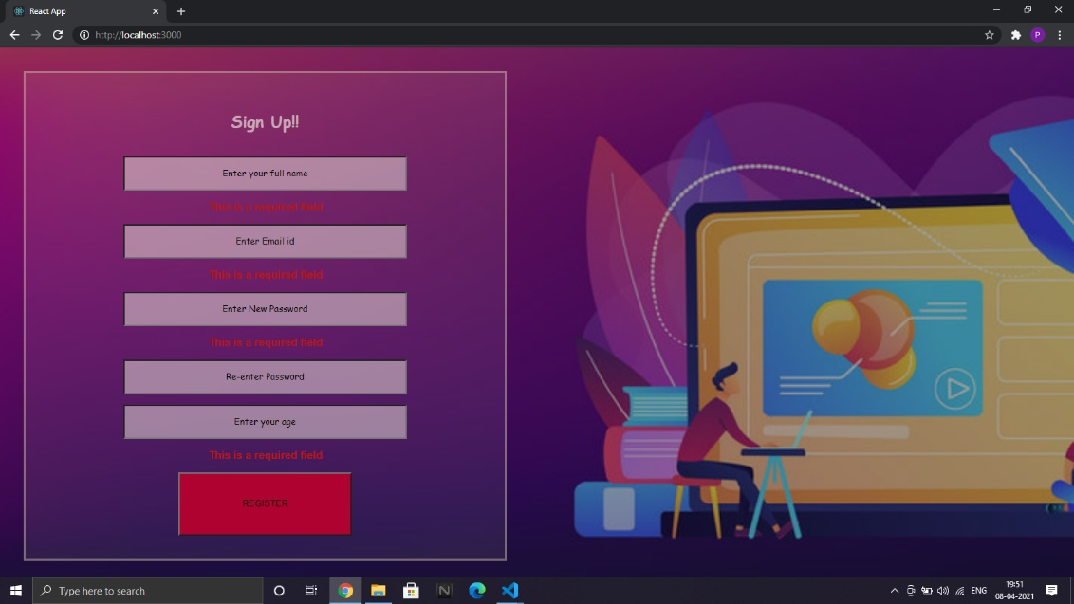
REGISTRATION AND VALIDATION
.

Slide 14

Login page

Slide 15
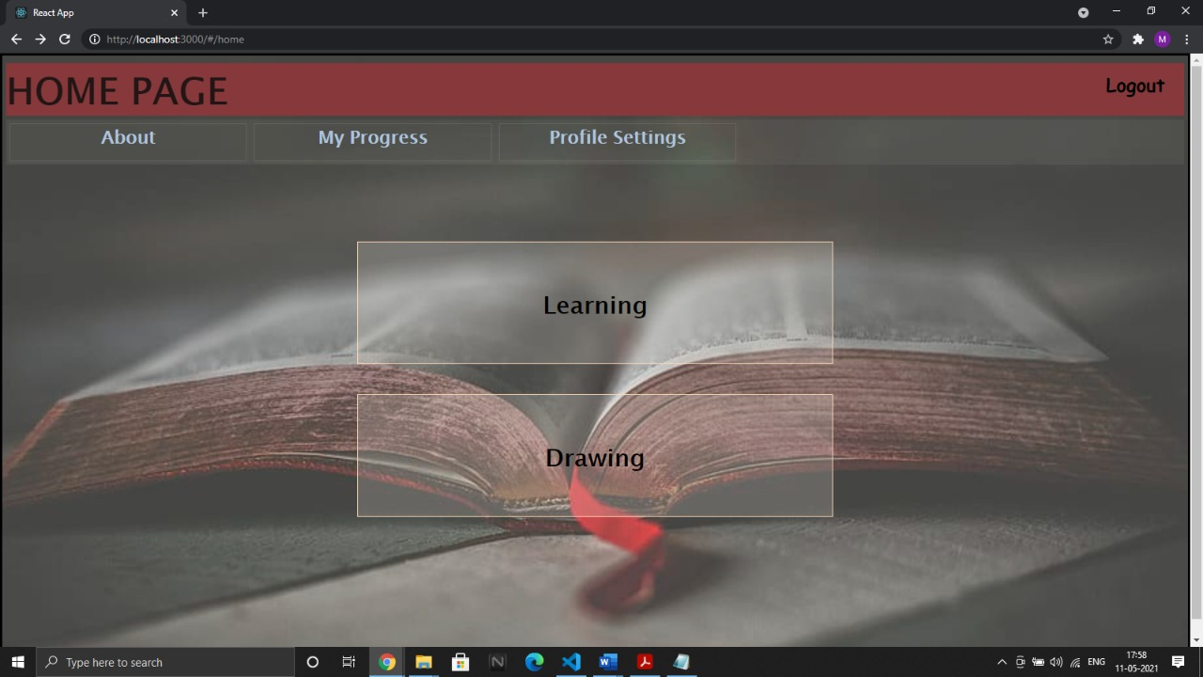
Navigation page
Home page for navigating between the pages.

Slide 16
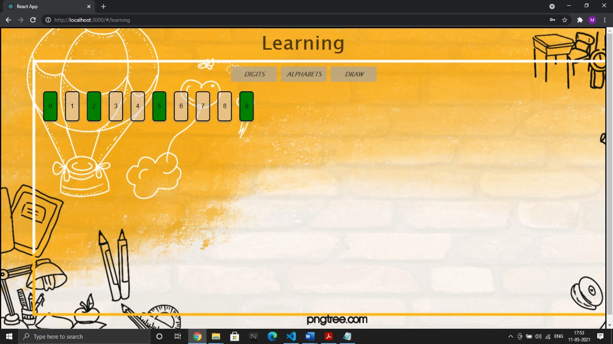
Learning section

Slide 17
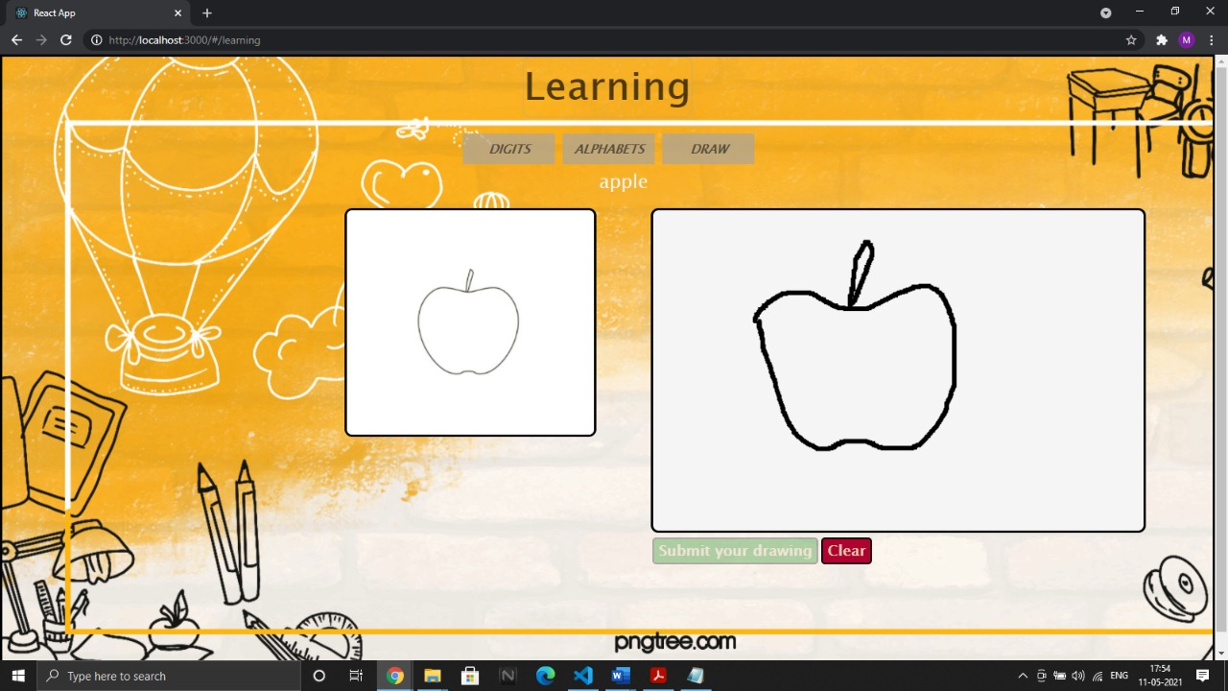

Slide 18
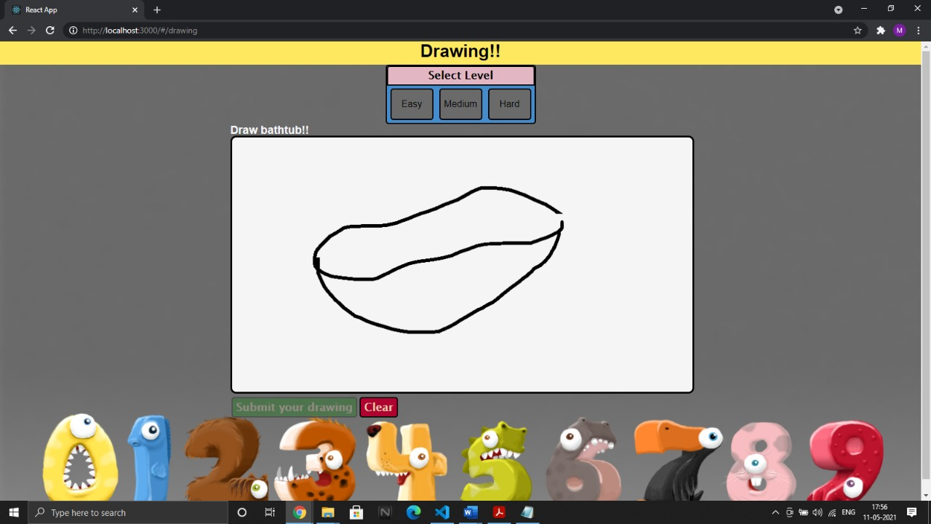
Drawing Section

Slide 19
DATA PRE-PROCESSING
The data sets are taken from Google quickdraw for doodle recognition, Kaggle datasets for digit and alphabet recognition. They are manually divided into three categories as easy, medium, and hard With 30 categories each. We randomly shuffle the data and take 70% for training and the rest for testing. The images are pre processed into 28 x 28 pixel matrices and converted into Gray scale images.as we don’t need colour for feature extraction in our project.

Slide 20
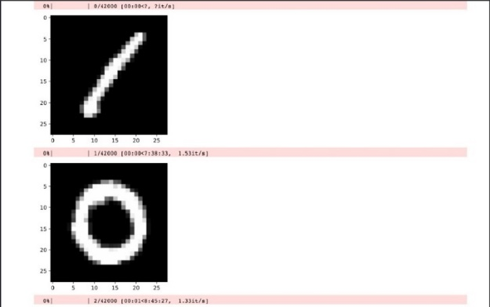
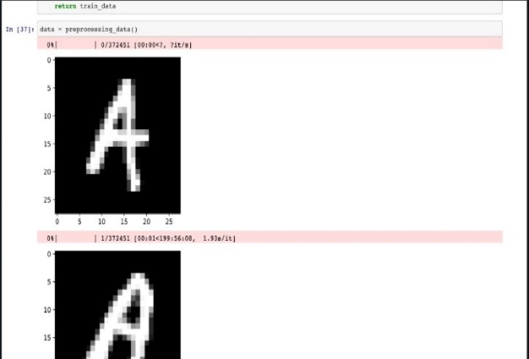
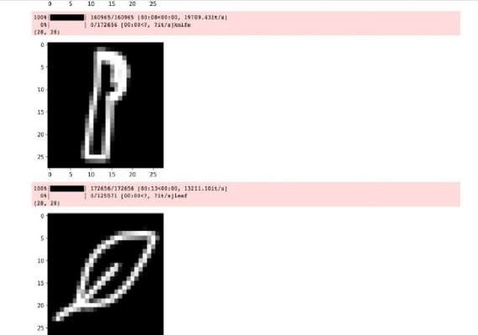
Data for Digits
Data for doodle
Data for Alphabets

Slide 21
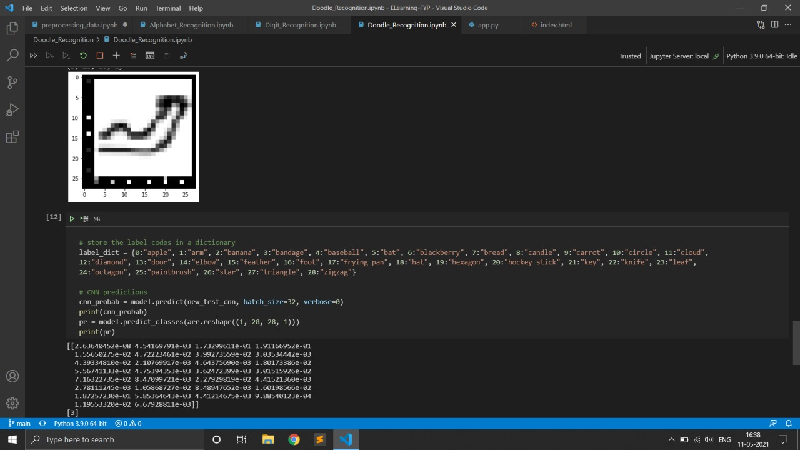
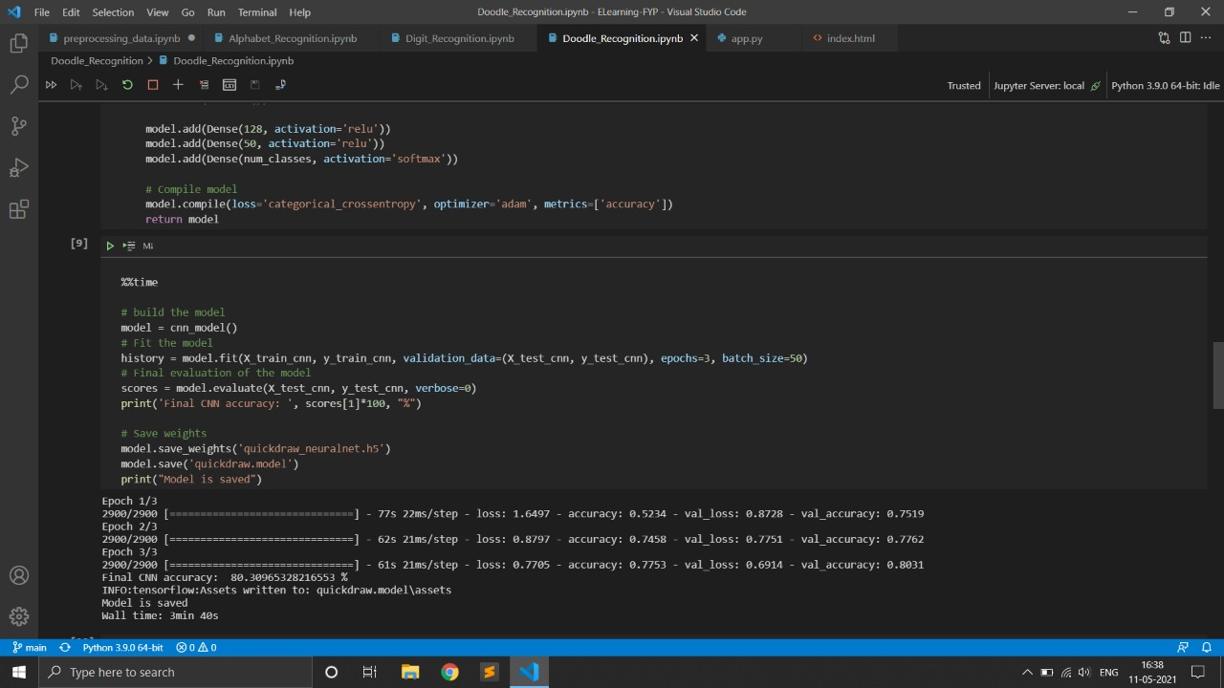
Images for data prediction

Slide 22
OUTPUT
we have designed a CNN algorithm for image classification and also it's accuarcy we're training and compiling the model once and using the saved model to predict sketches which are sent from UI. This will speed up the application.

Slide 23
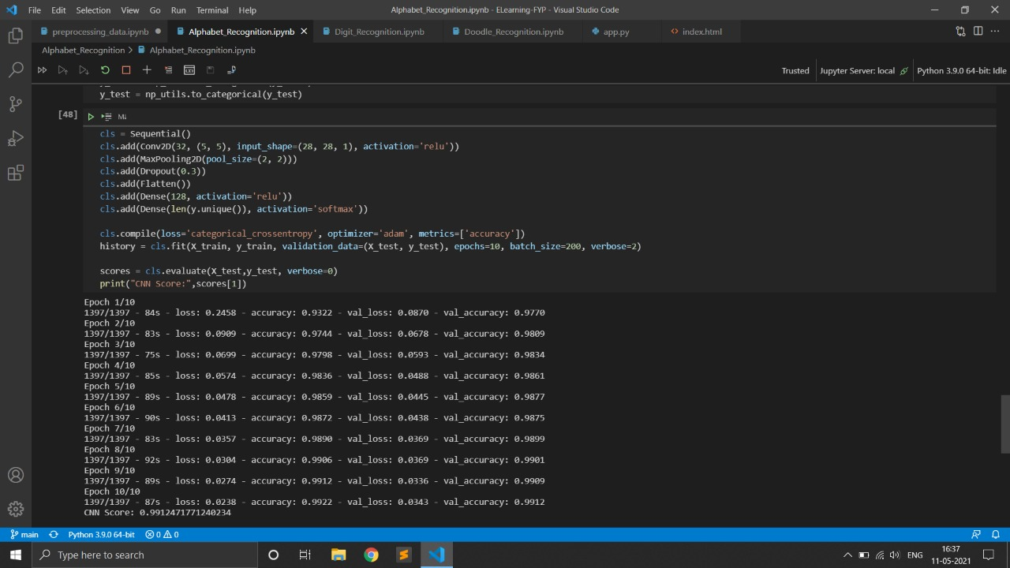
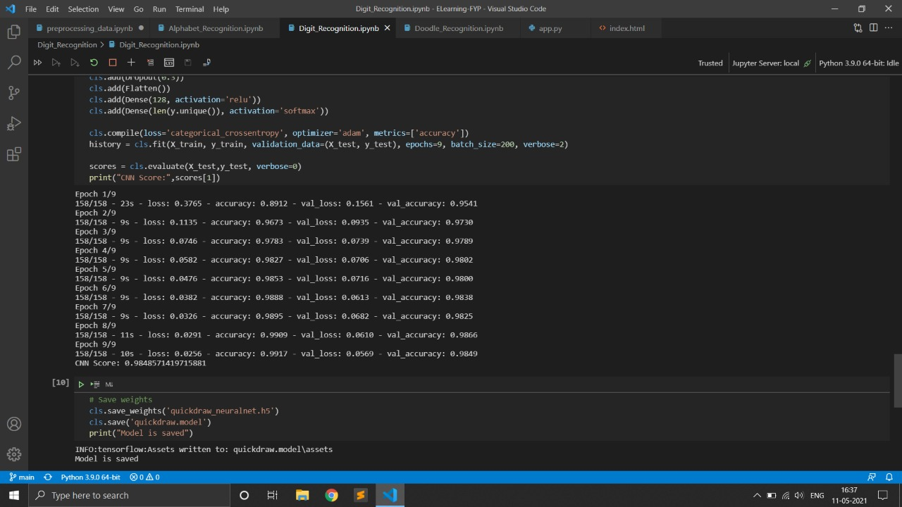

Slide 24
Reference
Anchit Shrivastava, Isha Jaggi, Shefali Gupta, Deepali Gupta “Handwritten digit recognition using machine learning: A review”
https://ieeexplore.ieee.org/abstract/document/8976601/authors#authors.
Tsung-Han Tsai, Po-Ting Chi, Kuo-Hsing Cheng “The sketch classifier technique with deep learning models realised in an embedded system”
https://ieeexplore.ieee.org/document/8724656/authors#authors.
Olisah Kingsley S and Mohamed Ismail Z “web-based E-learning for system for pre-school kids
https://www.researchgate.net/publication/319360301_Web_Based_E-learning_System_for_Pre-school_Kids
Rahul Chauhan, Kamal Kumar Ghanshala, R.C Joshi “convolutional neural network (CNN) for image detection and recognition”
https://ieeexplore.ieee.org/document/8703316

Slide 25
THANK YOU

